Slide 1
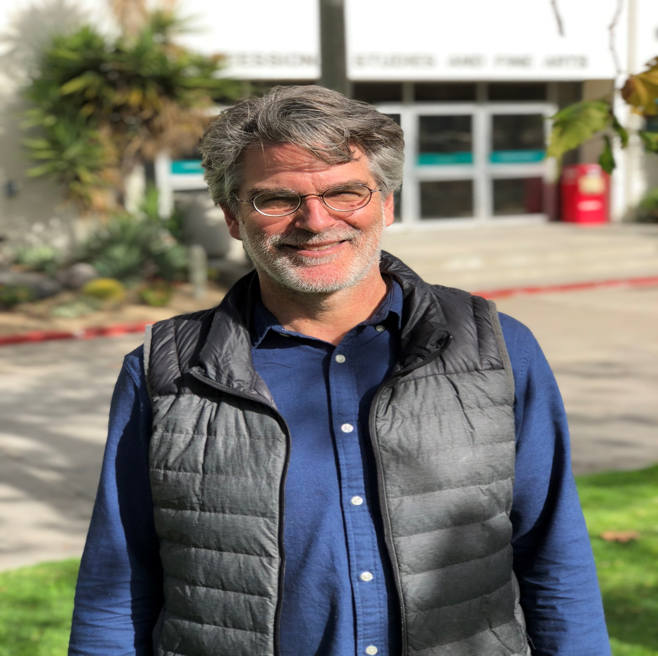
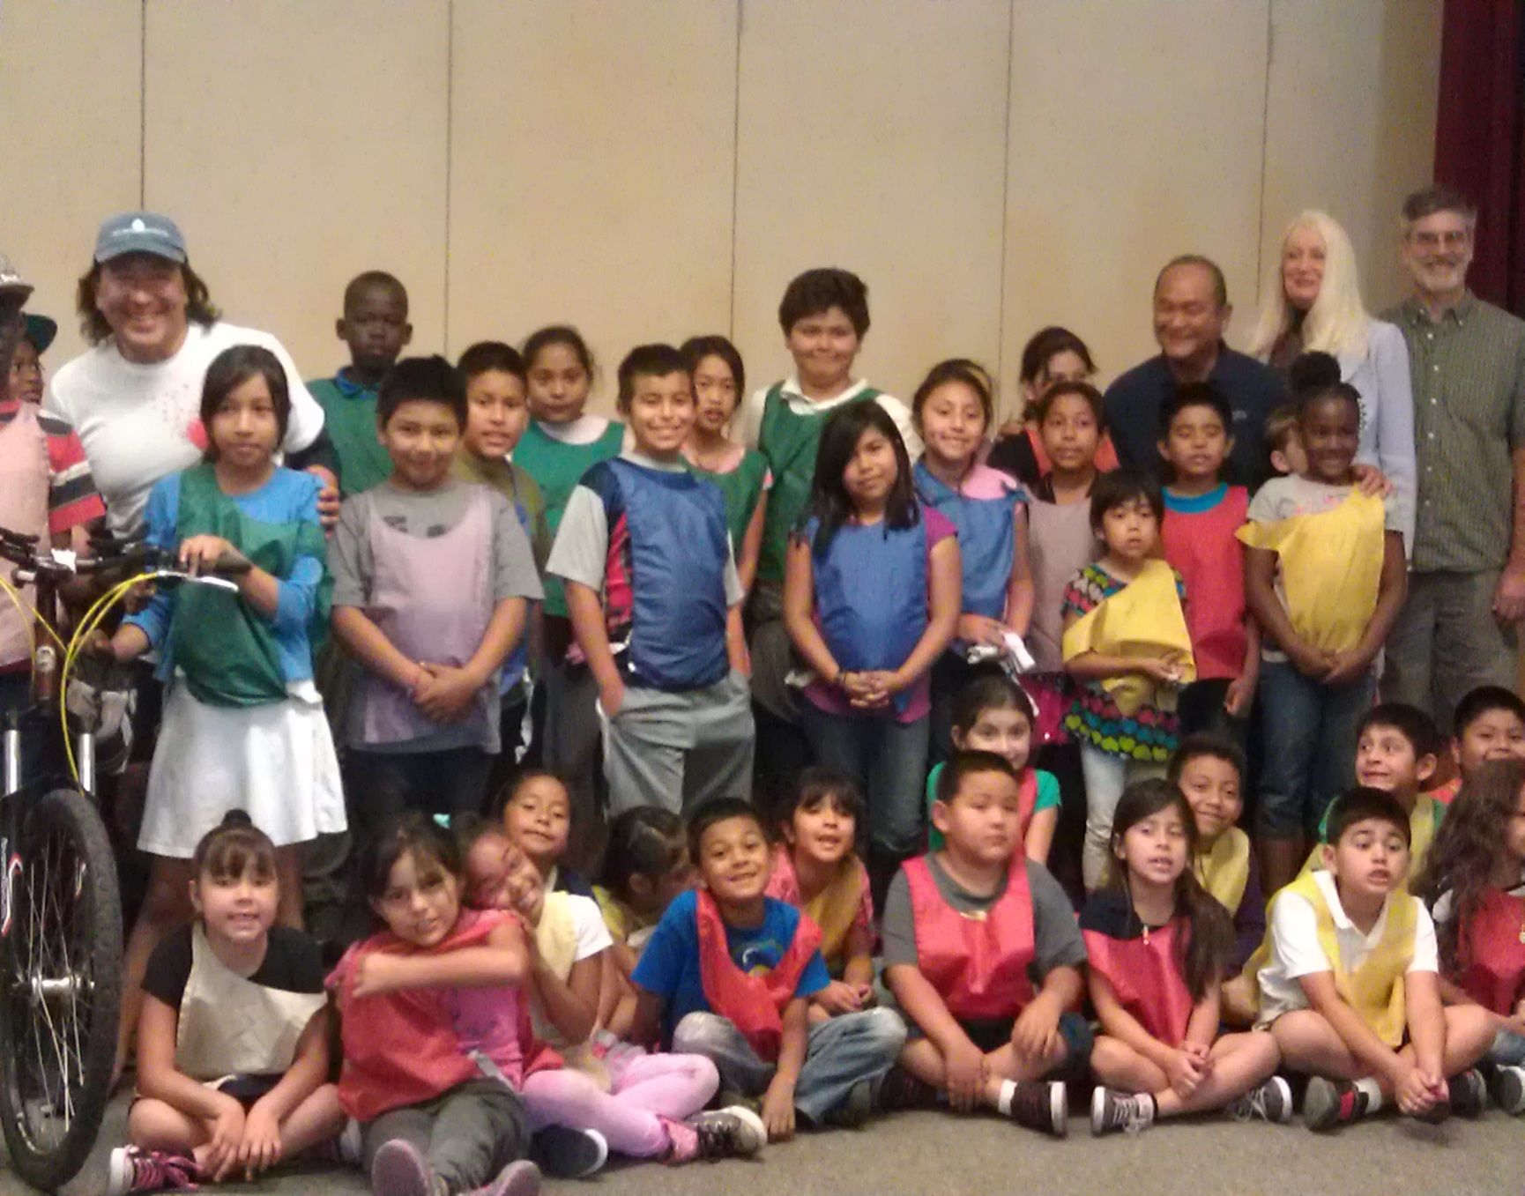
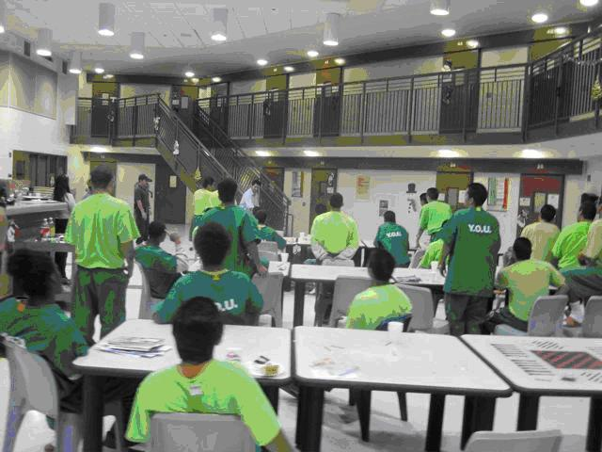
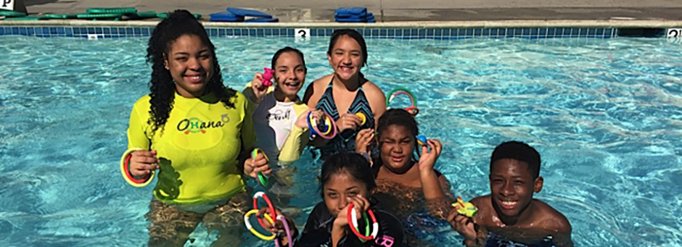
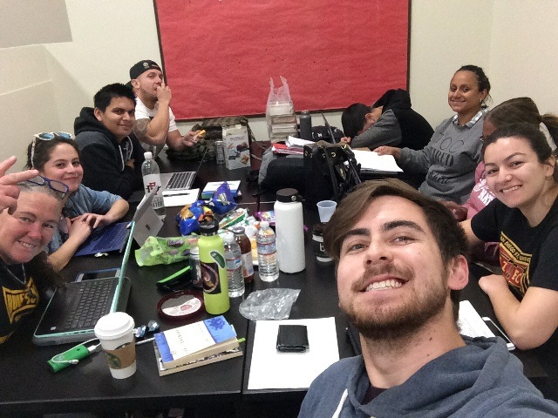
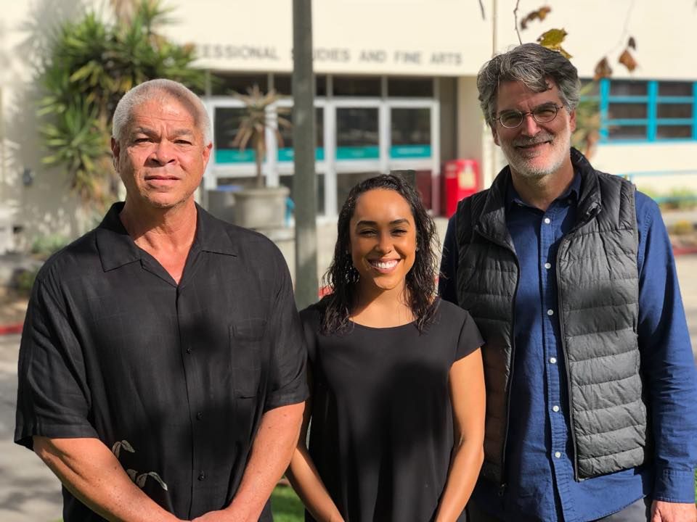
Restorative Justice in Action:
Project Rebound & CJ 543 - Community Resources in Criminal Justice
Instructor: Alan Mobley
About CJ 543
Spotlight: Project Rebound
The purpose of this course is to introduce students to the various agencies (and ideas) at work in the field(s) of justice. And this is a practicum course! Consequently, you will go out from the classroom to identify and work with local organizations as they pursue their respective pieces of the justice puzzle.
The primary goal of this course is to help students apply social science theories and methods toward the analysis of “real” problems encountered within the context of the field placement. In this way, theoretical understandings of issues will be integrated with supervised experience in the field.
The administration of justice is certainly one of the most important functions of government. In recent years, government has increased its efforts to encourage nongovernmental actors to play larger roles in justice system processes. Whether for the purposes of crime prevention, intervention, punishment, diversion, or community peacemaking, nongovernmental organizations, both profit and nonprofit, have taken on important roles in the administration of justice. In class, we discuss the social, political, and economic contexts that justice agencies help to create, and within which they operate. In our readings and discussions we will critique the very principles that underlie key concepts such as “justice,” “community,” and “organizations.”
Project Rebound was introduced to San Diego State University in 2016. The program supports the success of formerly incarcerated college students by offering the opportunity and resources needed to successfully transition and acclimate to a university campus.
The program was created with the intention of demonstrating that education is a viable alternative to incarceration and recidivism, and that mentoring provides prosocial benefits, including access to a reliable listener and association with others outside of a client’s existing social network.
By offering resources and connections with supportive entities, Project Rebound helps students meet their basic needs, so they can concentrate on gaining expertise in their chosen field of study and achieve educational success and personal empowerment.
Photos from Student Fieldwork Sites
Cherokee Point
Elementary
Project Pooch
Service Learning Component
Youth Offender Unit
How is service learning enacted in the course?
Students are required to volunteer 60 hours of fieldwork during the semester with a community-based organization and/or local corrections agencies.
How do students demonstrate their experiences?
Completion of fieldwork journal
Completion of research paper
Presentation of research and practicum takeaways
Students are also strongly encouraged to keep a verifiable log of their hours
CJ 543 Partnerships
Project Rebound
Southwestern College / Richard J. Donovan (RJD) State Prison
Father Joe’s Villages
YMCA
San Diego Unified School District
Star/Pal
Project Pooch
Second Chance Program
YMCA
Study Group
Project Rebound Staff
Service Learning Best Practices Exhibition

